Slide 1
KNOWLEDGE BASES and LOGICAL REASONING

Slide 2
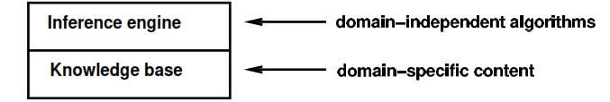
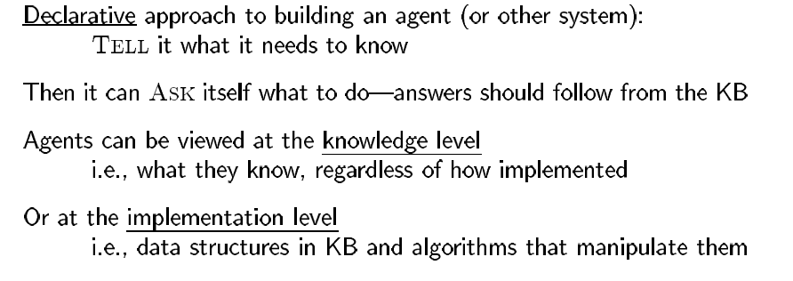
Set of sentences in formal language
Knowledge Representation Language : Each sentence expressed in language
Concept of TELL and ASK

Slide 3
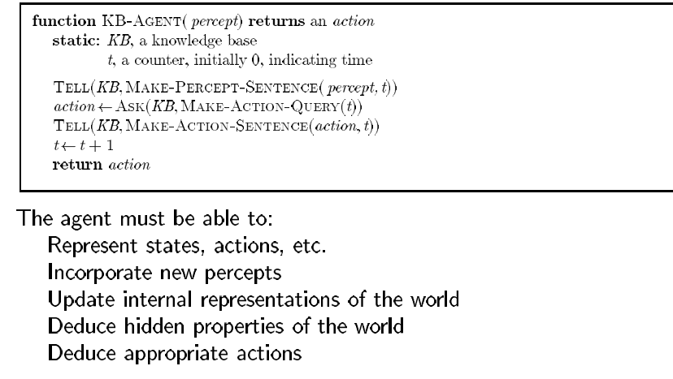
KNOWLEDGE BASED AGENT

Slide 4
STEPS IN KNOWLEDGE ENGINEERING PROCESS
Identify the task.
Assemble the relevant knowledge.
Decide on a vocabulary of predicates, functions, and constants.
Encode general knowledge about the domain.
Encode a description of the specific problem instance
Pose queries to the inference procedure and get answers.
Debug the knowledge base.

Slide 5
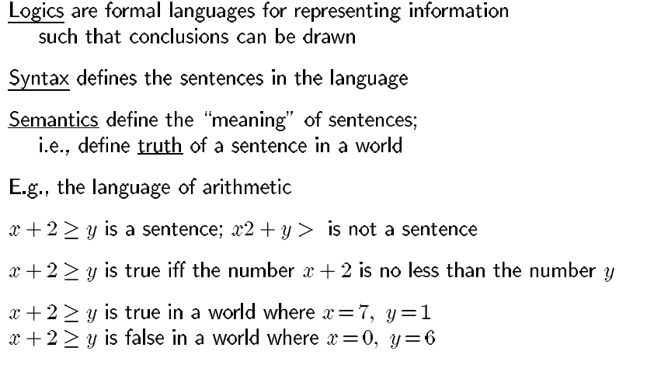
LOGIC

Slide 6
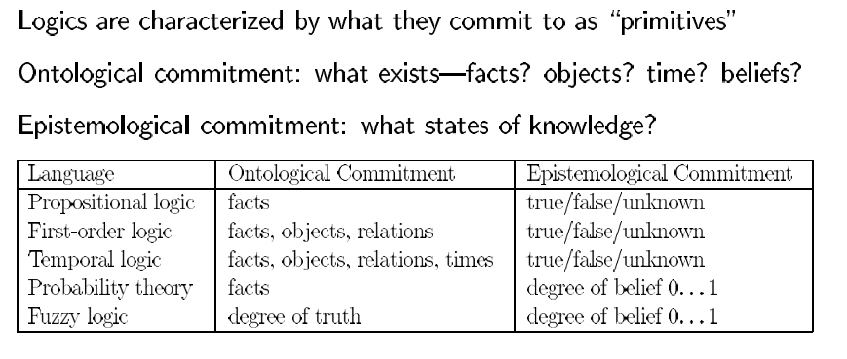
TYPES OF LOGIC

Slide 7
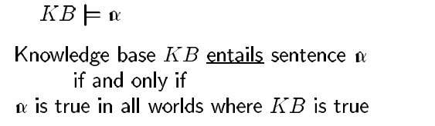
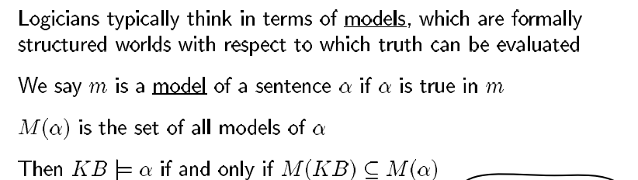
ENTAILMENT

Slide 8
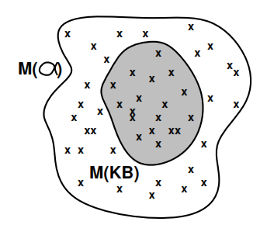
MODEL

Slide 9
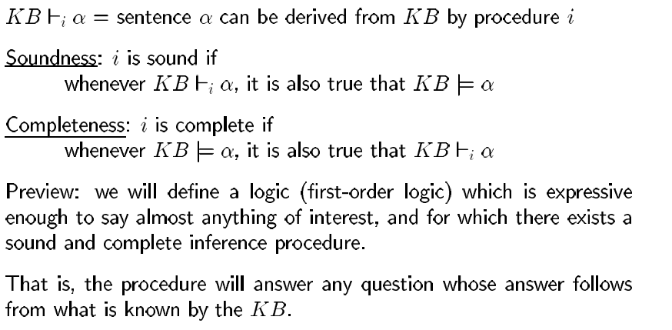
INFERENCE

Slide 10
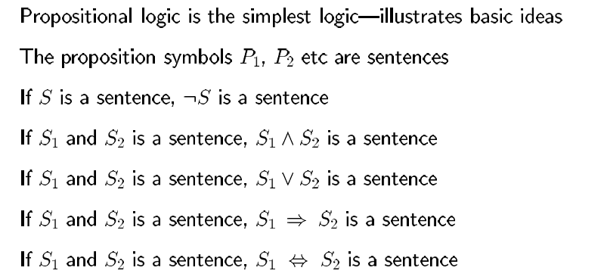
PROPOSITIONAL LOGIC

Slide 11
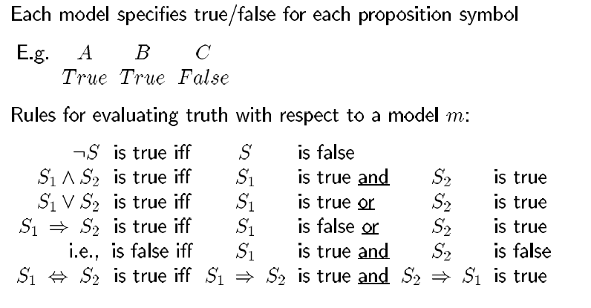
PROPOSITIONAL LOGIC ( Contd.)

Slide 12
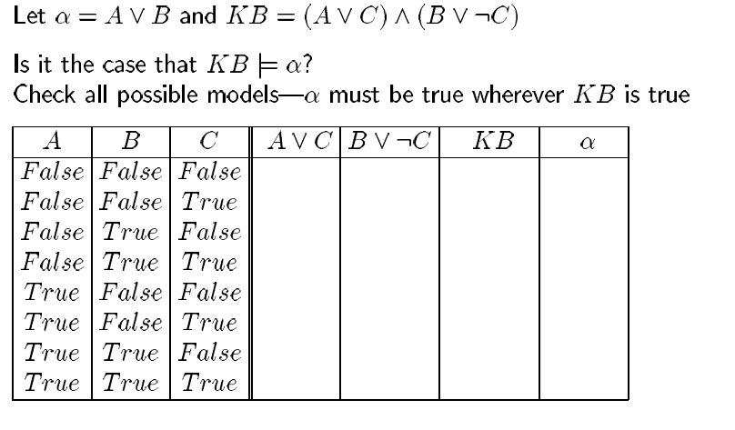
PROPOSITIONAL LOGIC - ENUMERATION

Slide 13
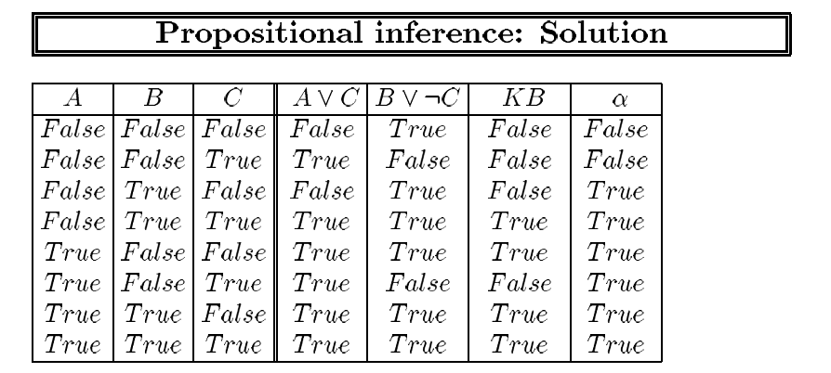
PROPOSITIONAL INFERENCE - SOLUTION

Slide 14
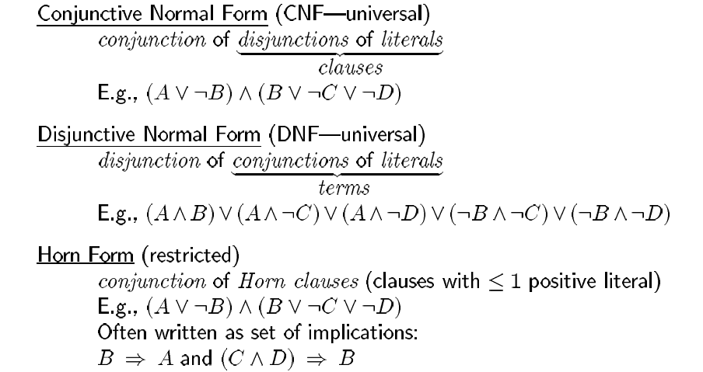
FORMS OF REPRESENTATION

Slide 15
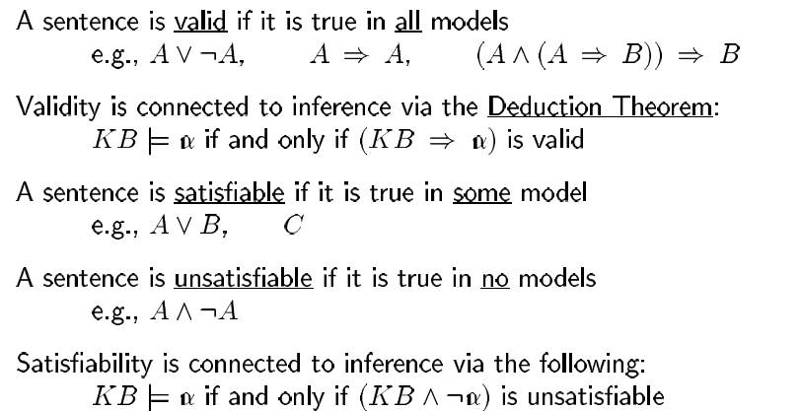
VALIDITY AND SATISFIABILITY

Slide 16
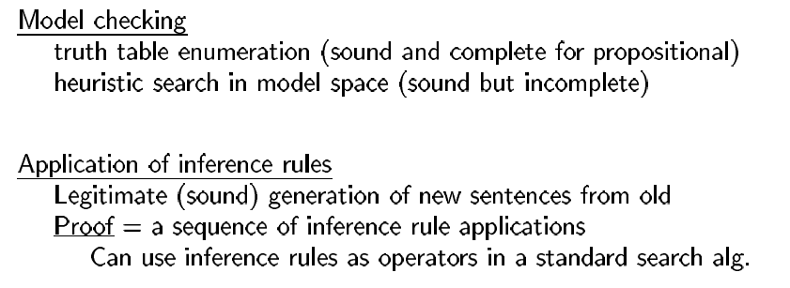
PROOF METHODS

Slide 17
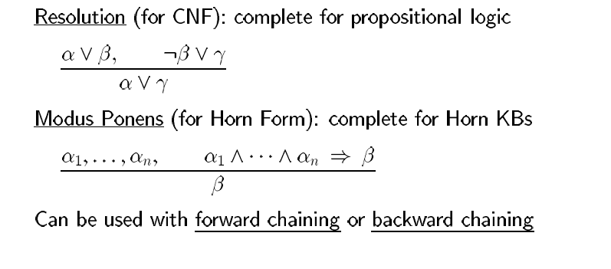
INFERENCE RULES FOR PROPOSITIONAL LOGIC

Slide 18
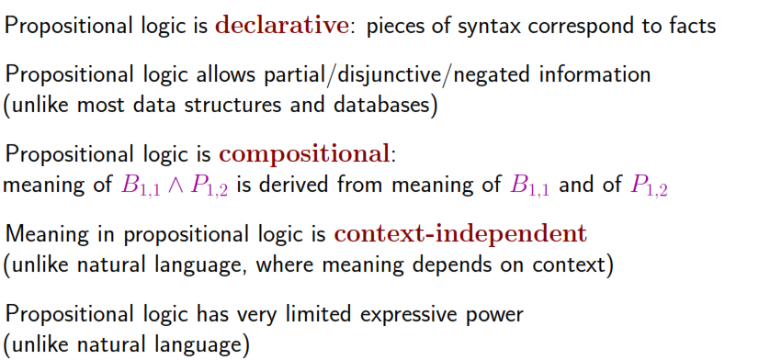
PROS and CONS of PROPOSITIONAL LOGIC

Slide 19
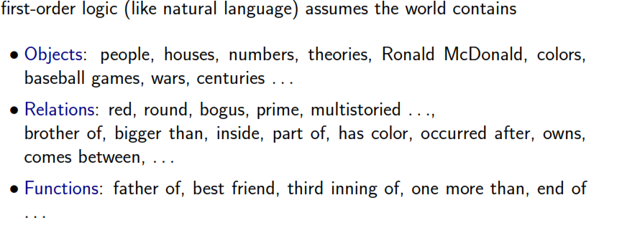
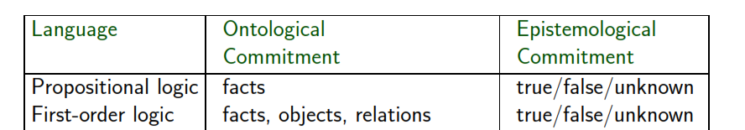
FIRST ORDER LOGIC

Slide 20
CONCEPTS
Functions
Predicates
Constants
Variables
Connectives
Equality ( Terms are true under a given interpretation )
Quantifiers with examples
Atomic and Complex sentences with examples

Slide 21
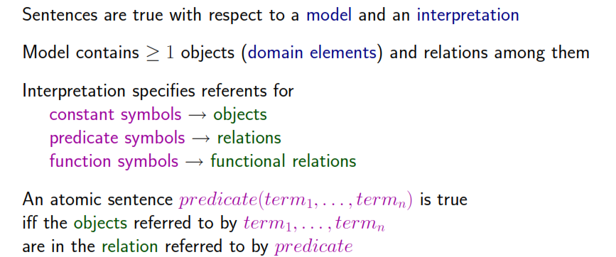
TRUTH IN FOL

Slide 22
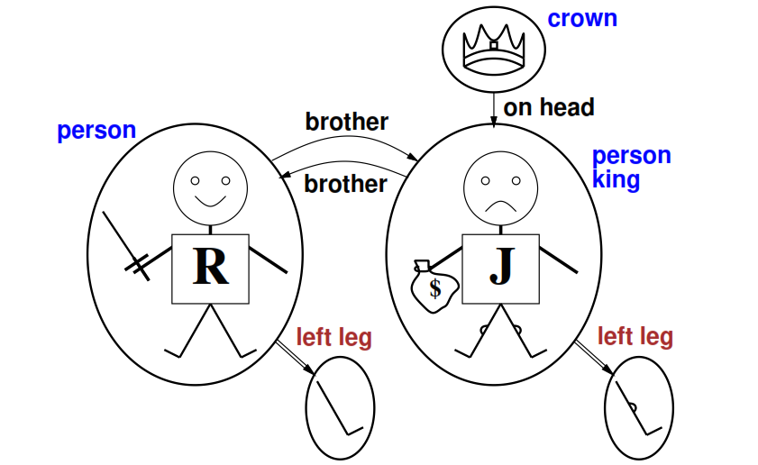
MODELS for FOL

Slide 23
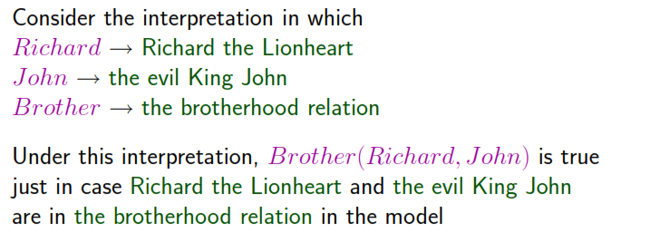

EXAMPLE for MODEL

Slide 24
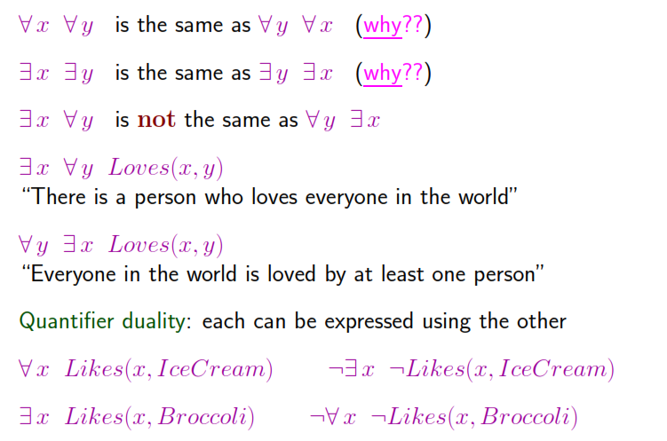
PROPERTIES OF QUANTIFIERS

Slide 25
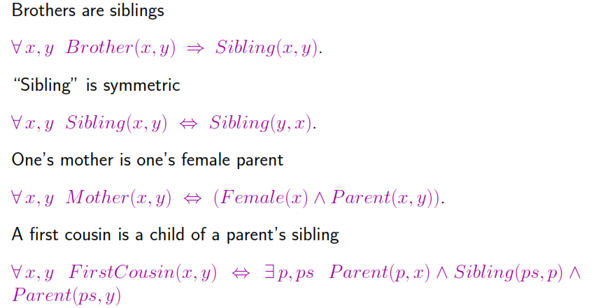
OTHER INTERESTING SENTENCES

Slide 26
REASONING PATTERNS IN PROPOSITIONAL LOGIC
MODUS PONENS
AND ELIMINATION
RESOLUTION

Slide 27
HORN CLAUSES
Maximum – one positive literal
Can be written as an implication
Horn clauses with exactly one positive literal ( Head )– Definite clauses ( Negative literal – body )
Inferences with Horn Clauses can be done through forward and backward chaining algorithms
Deciding entailment with Horn clauses can be done in time that is linear with the size of the knowledge base.

Slide 28
FORWARD and BACKWARD CHAINING
Forward Chaining – Data driven reasoning
Backward Chaining – Goal Directed reasoning

Slide 29
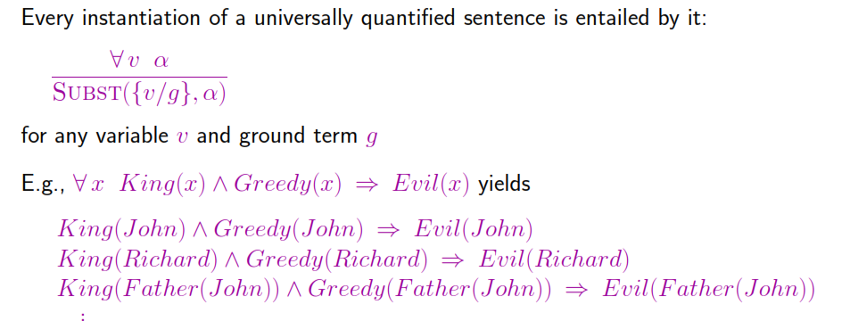
INFERENCES IN FOL

Slide 30
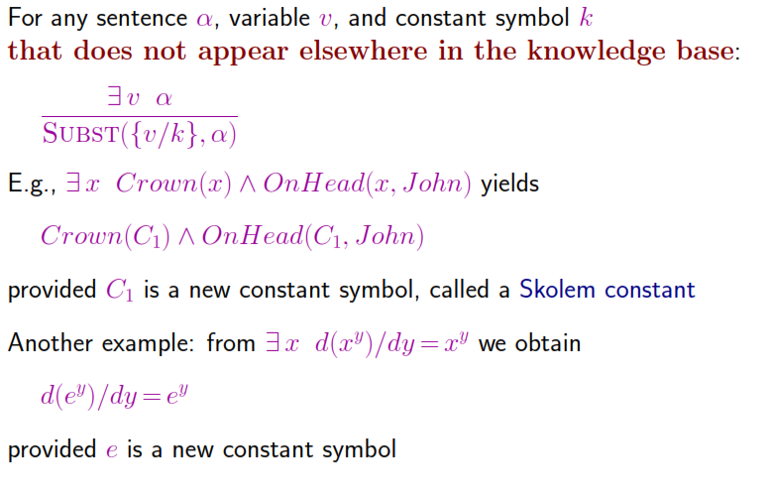
EXISTENTIAL INSTANTIATION

Slide 31
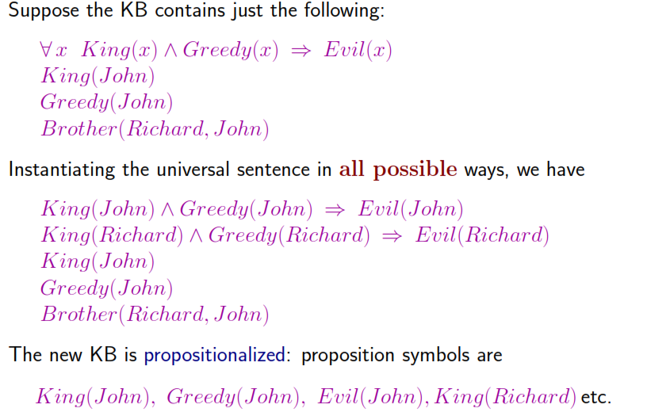
REDUCTION TO PROPOSITIONAL INFERENCE

Slide 32
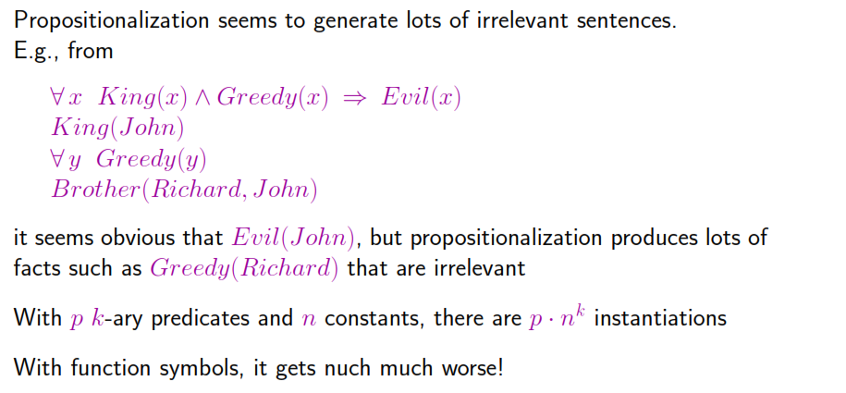
PROBLEMS WITH PROPOSITIONALIZATION

Slide 33
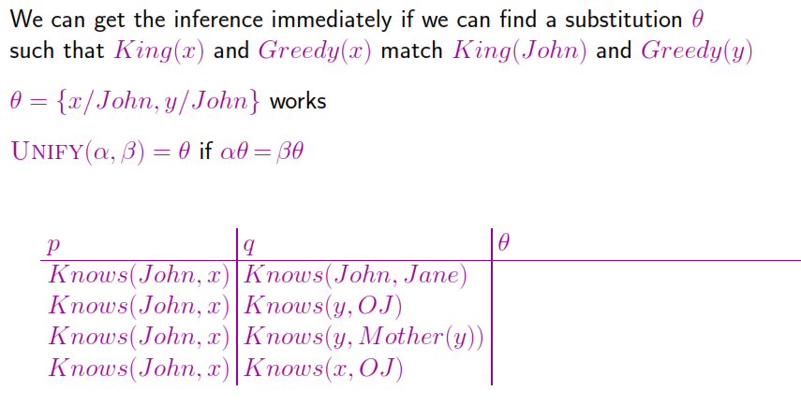
UNIFICATION

Slide 34
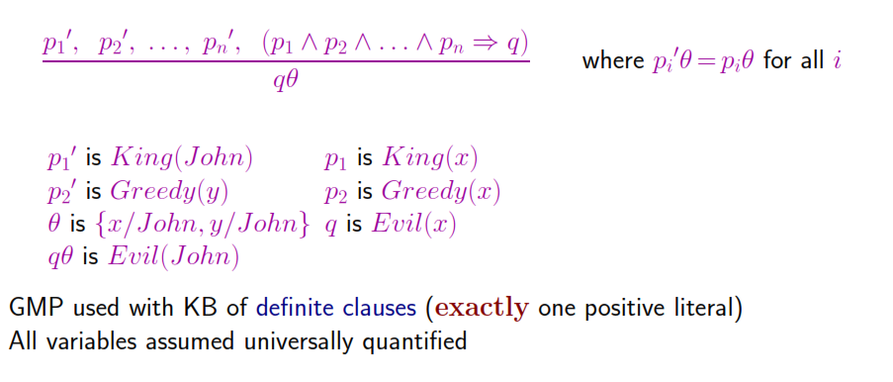
GENERALIZED MODUS PONENS(GMP)

Slide 35
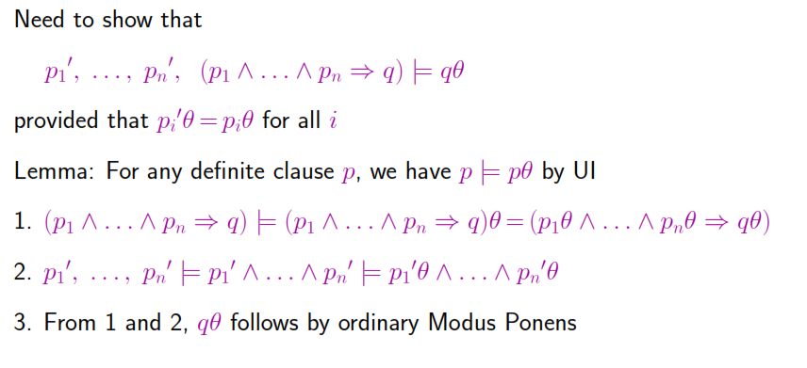
SOUNDNESS OF GMP

Slide 36
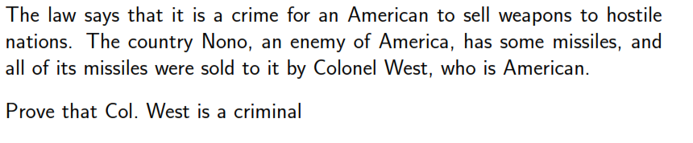
SAMPLE PROBLEM – KNOWLEDGE BASE

Slide 37
UNIFICATION and LIFTING
Unification - Explanation
Lifting – Explanation
Generalised Modus Ponens – Lifted Version of Modus Ponens

Slide 38
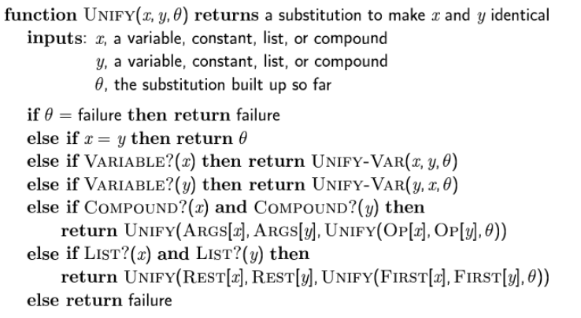
UNIFICATION ALGORITHM

Slide 39
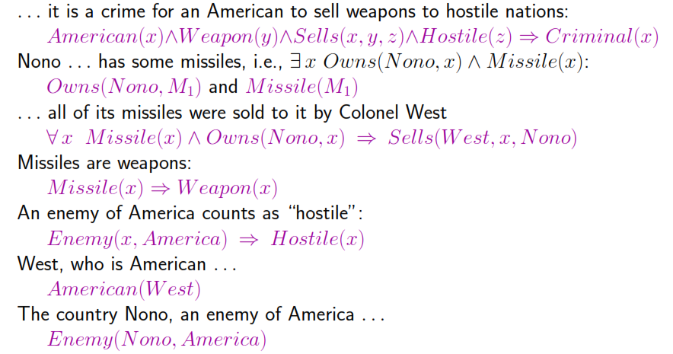
CONVERSION for sentences

Slide 40
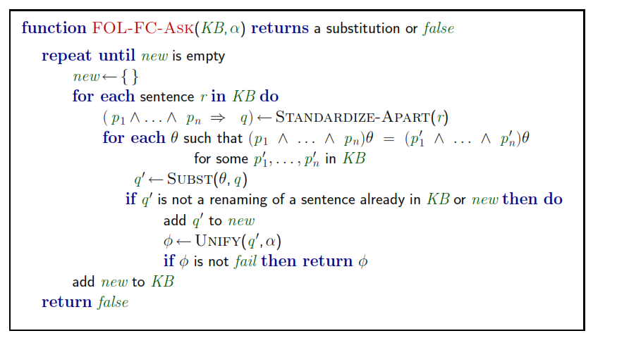
FORWARD CHAINING ALGORITHM

Slide 41
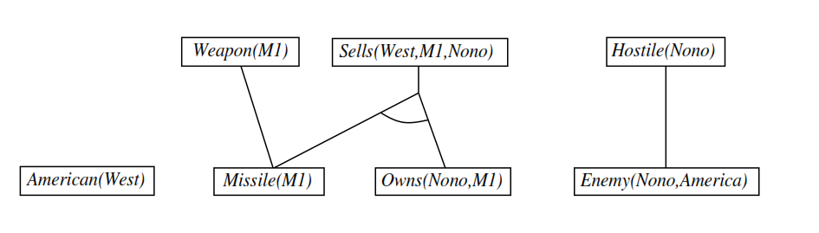
FORWARD CHAINING - PROOF

Slide 42
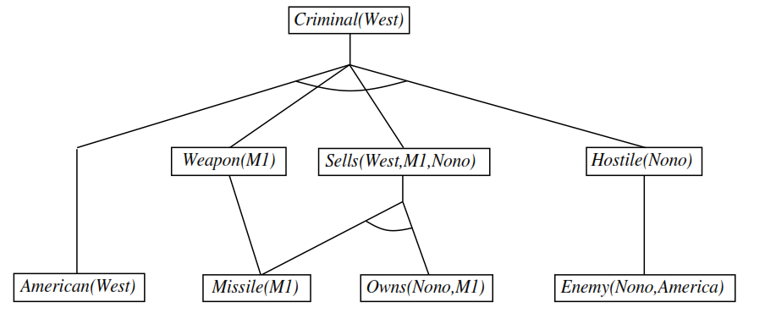
FORWARD CHAINING PROOF – CONTD.

Slide 43
FIRST ORDER LOGIC
Forward Chaining used widely inductive databases
Additional Properties
Complete for definite clauses
May not terminate in general if not entailed
Entailment with definite clauses - Semidecidable

Slide 44
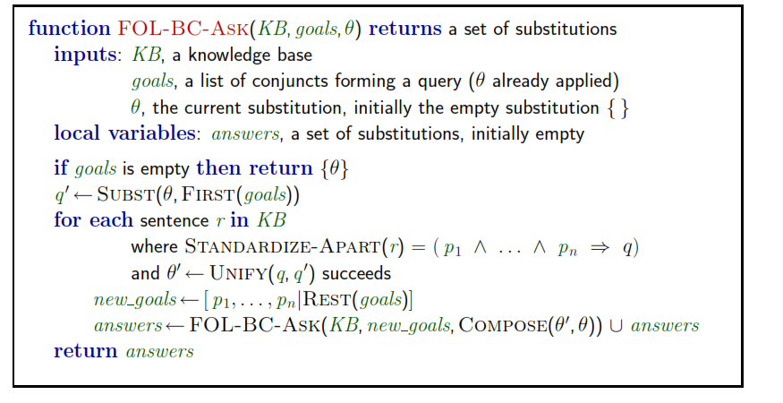
BACKWARD CHAINING

Slide 45

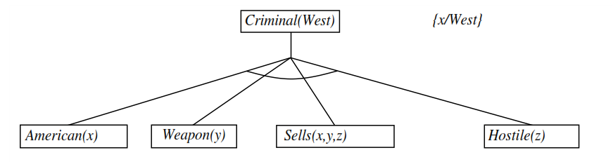
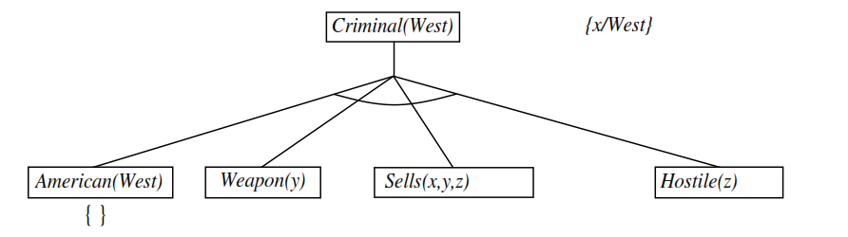
BACKWARD CHAINING - EXAMPLE

Slide 46
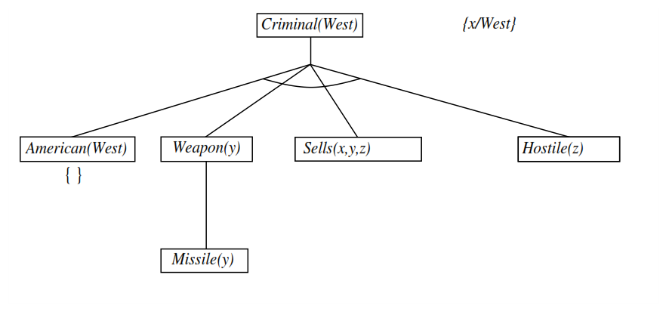
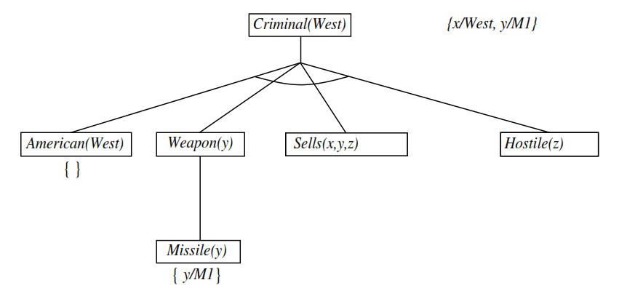

Slide 47
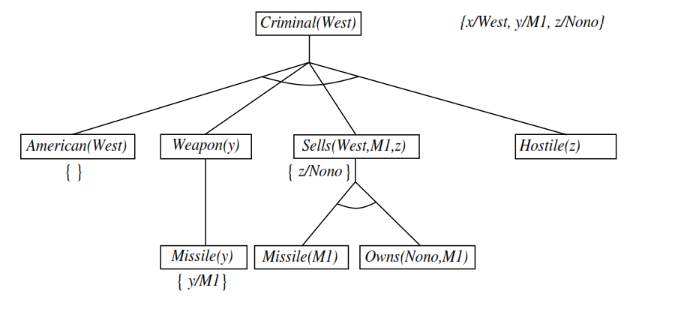
BACKWARD CHAINING – Contd.

Slide 48
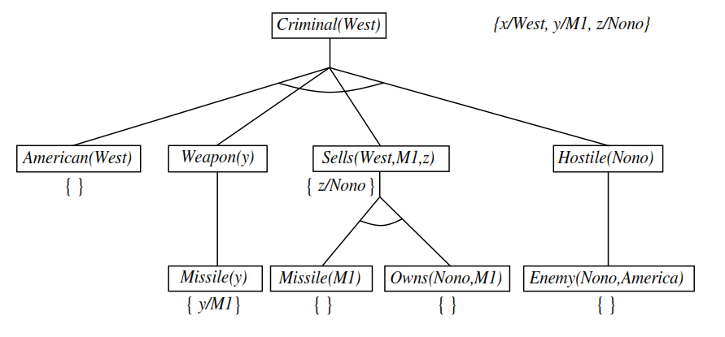

Slide 49
PROPERTIES OF BACKWARD CHAINING
Depth first recursive proof search : Space – linear in size
Incomplete due to infinite loops
Insufficient due to repeated subgoals
Widely used for logic programming

Slide 50
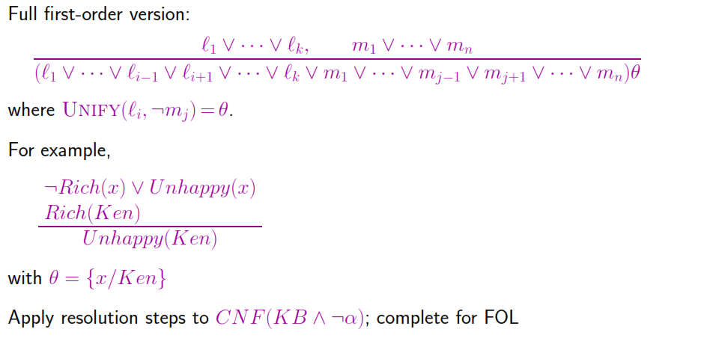
RESOLUTION

Slide 51
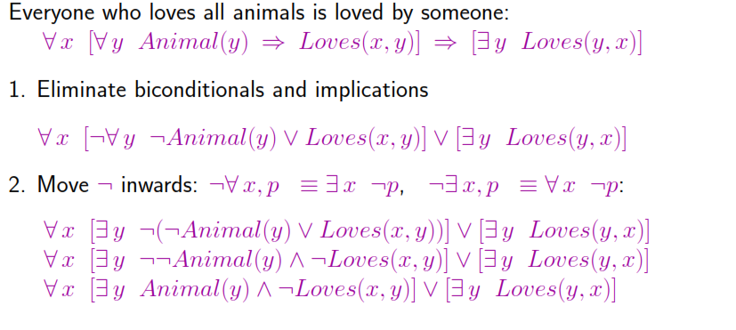
CONVERSION to CNF

Slide 52
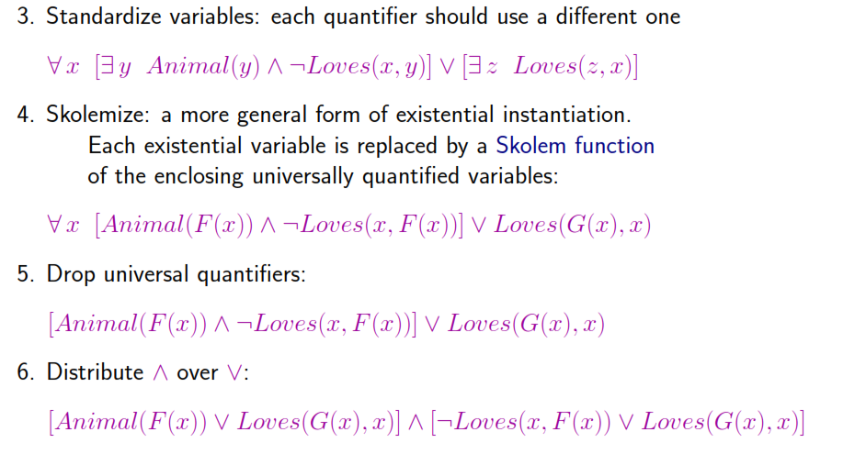
CONVERSION to CNF(Contd. )

Slide 53
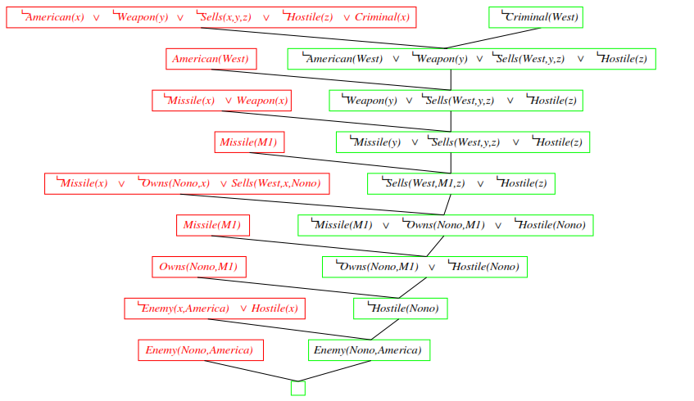
RESOLUTION PROOF BY REFUTATION

Slide 54
RESOLUTION STRATEGIES
UNIT PREFERENCE
Unit Resolution incomplete but complete for Horn Knowledge bases
SET OF SUPPORT
Goal Directed
Reduces Search space
Proper choice needed
INPUT RESOLUTION
Every resolution combines one of input sentences ( from knowledge base or query ) with some other sentence
SUBSUMPTION
Helps in keeping Knowledge Base small

